Slide 1
Hazards

Slide 2
Hazards
Type of hazards:
Structural hazards
Data hazards
Control hazards
Handling hazards:
Inserting NOP（software）
Forwarding, R-Type-use（hardware)
Stalls, load-use (hardware)
Special dealing with branch instruction

Slide 3
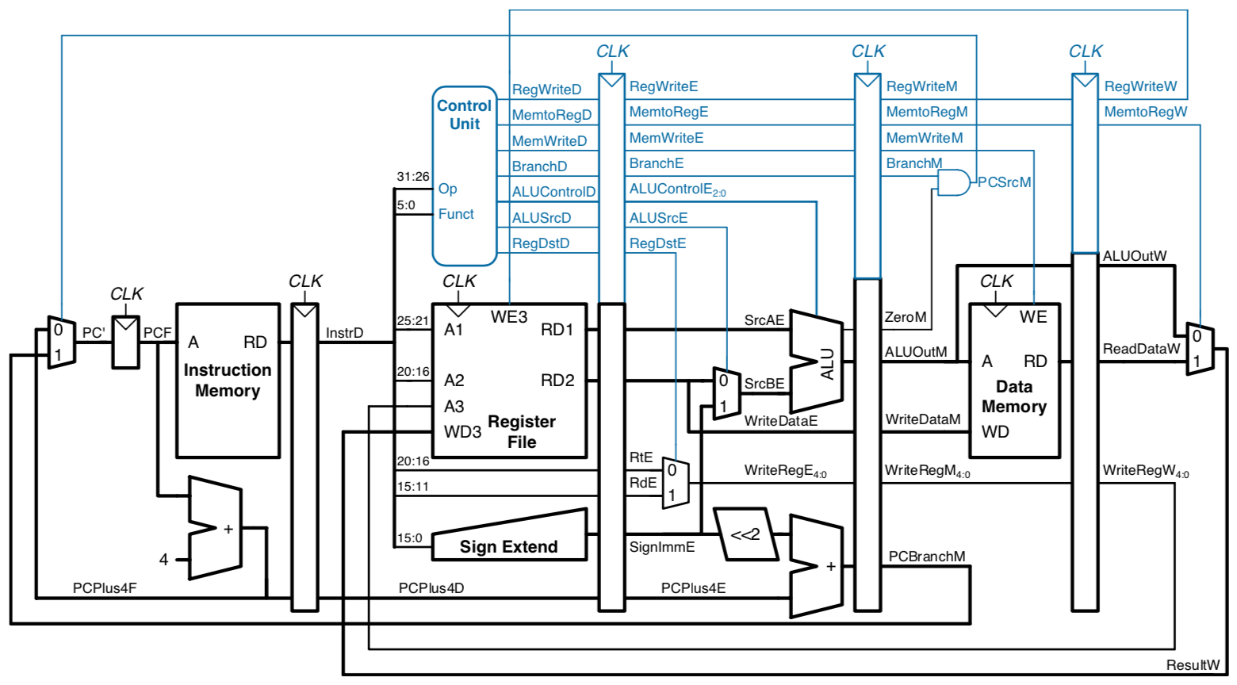
Pipelined Processor with Control

Slide 4
Data Forwarding

Slide 5
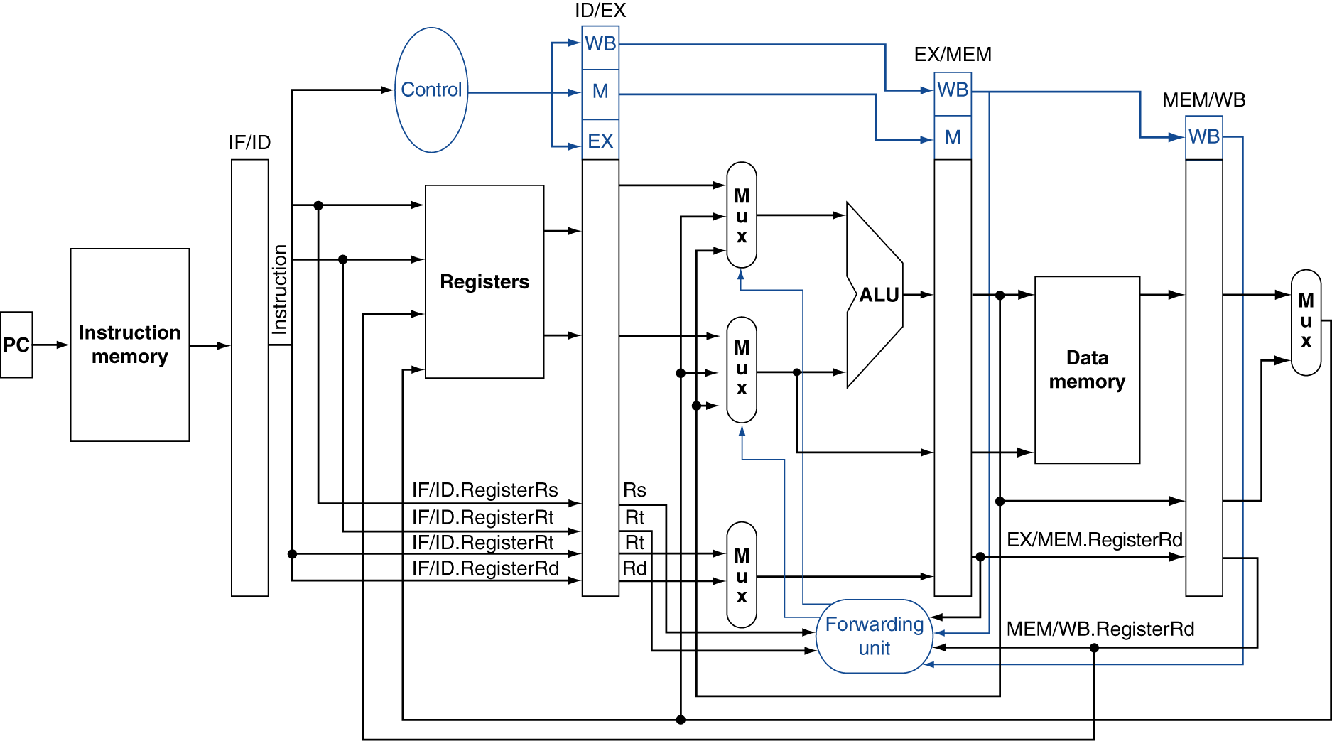
Data Forwarding

Slide 6
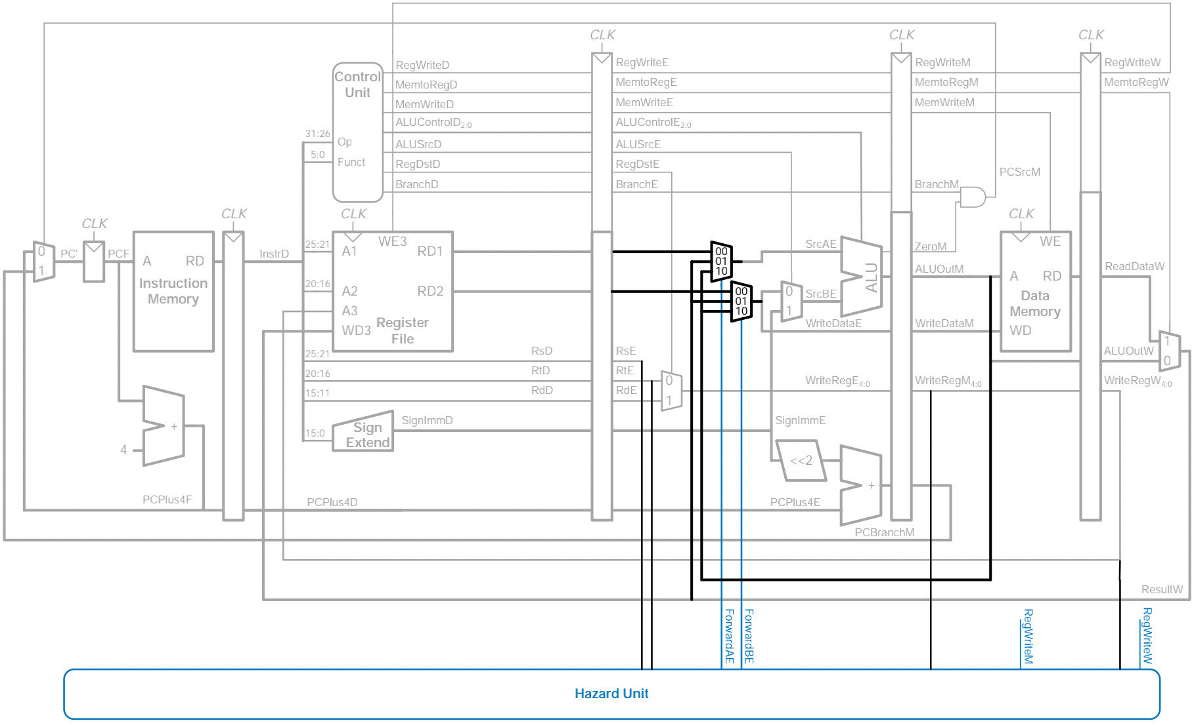
Pipelined Processor with Data Forwarding

Slide 7
Stalling

Slide 8
Stalling

Slide 9
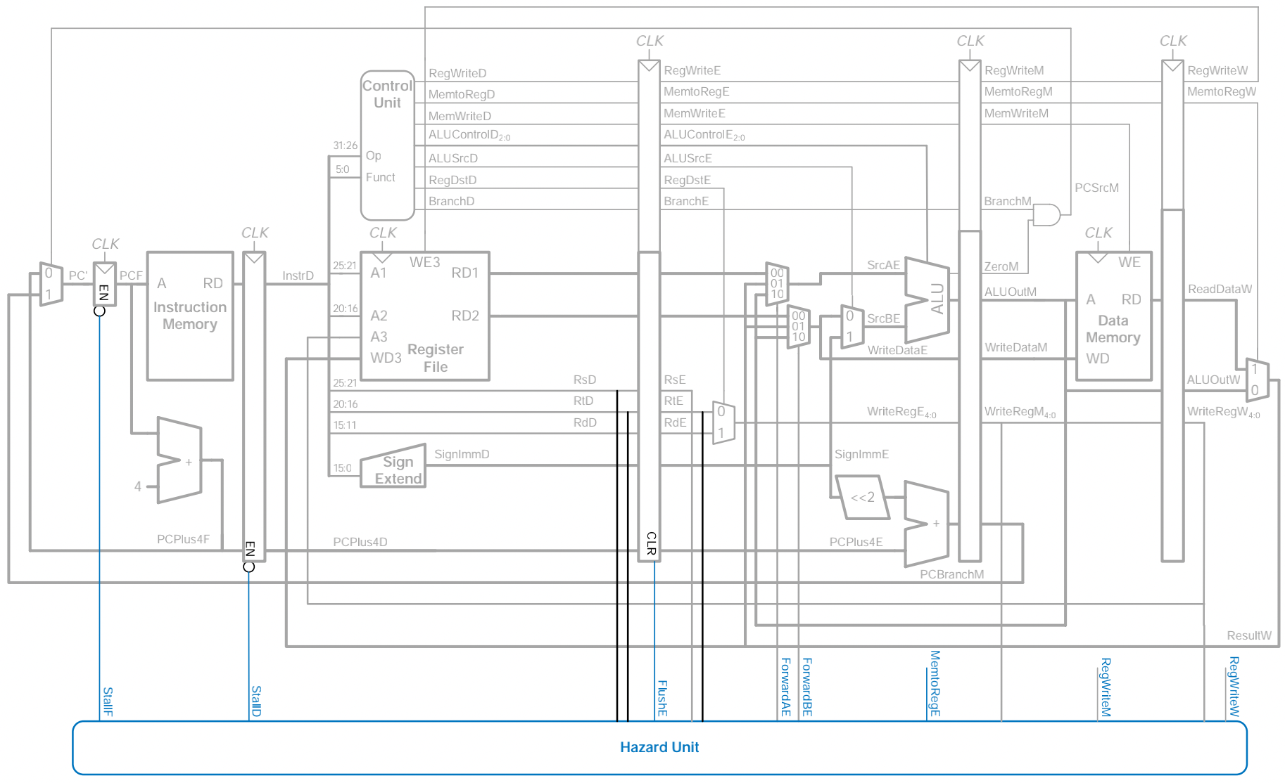
Pipelined Processor with Stalls

Slide 10
Branch

Slide 11
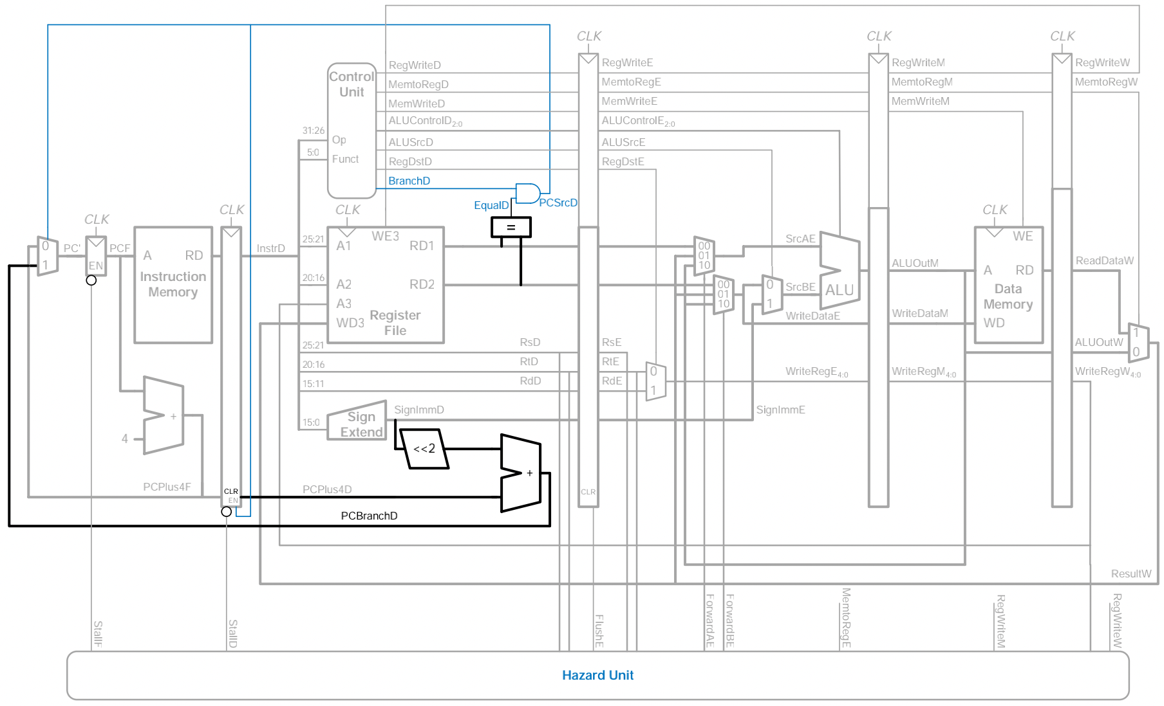
Branch

Slide 12
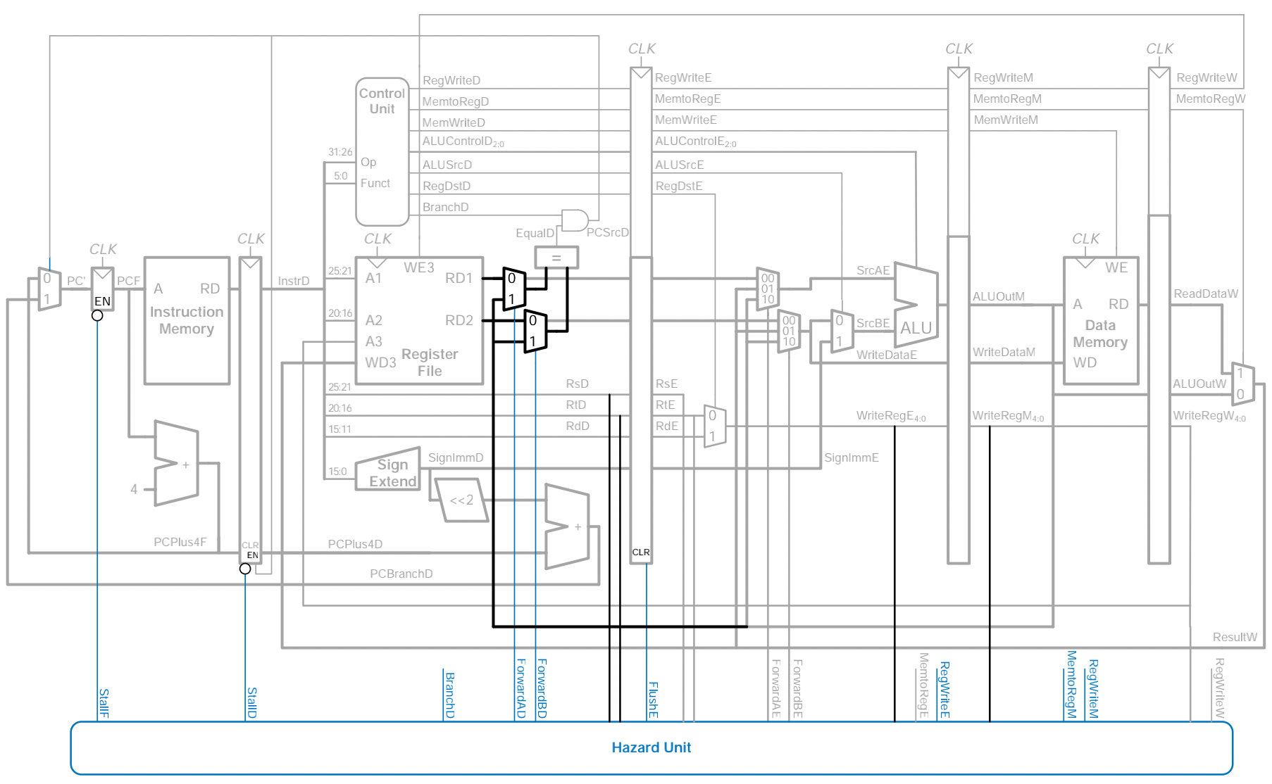
Pipelined Processor with full hazard handling

